Slide 1
Hack the Future: A Gen AI Sprint Powered by Data

Slide 2
Theme
AI-Powered Automation for Medical Documentation and Research
AI-powered automation is transforming the landscape of medical documentation and research by streamlining data entry, reducing human error, and enhancing efficiency. Through technologies like Natural Language Processing (NLP), machine learning, and intelligent voice recognition, healthcare professionals can automate clinical note-taking, transcriptions, and data analysis in real-time. This not only saves valuable time but also improves the accuracy of patient records and accelerates research by mining vast datasets for insights. The integration of AI ensures faster decision-making, improved patient outcomes, and a significant reduction in administrative burdens for medical staff.

Slide 3

Guidelines
The template should consist of the following and it is mandated to be used by your team for submitting your innovative ideas/solutions. Follow file naming format: Team name_Idea Name.pptx

Slide 4



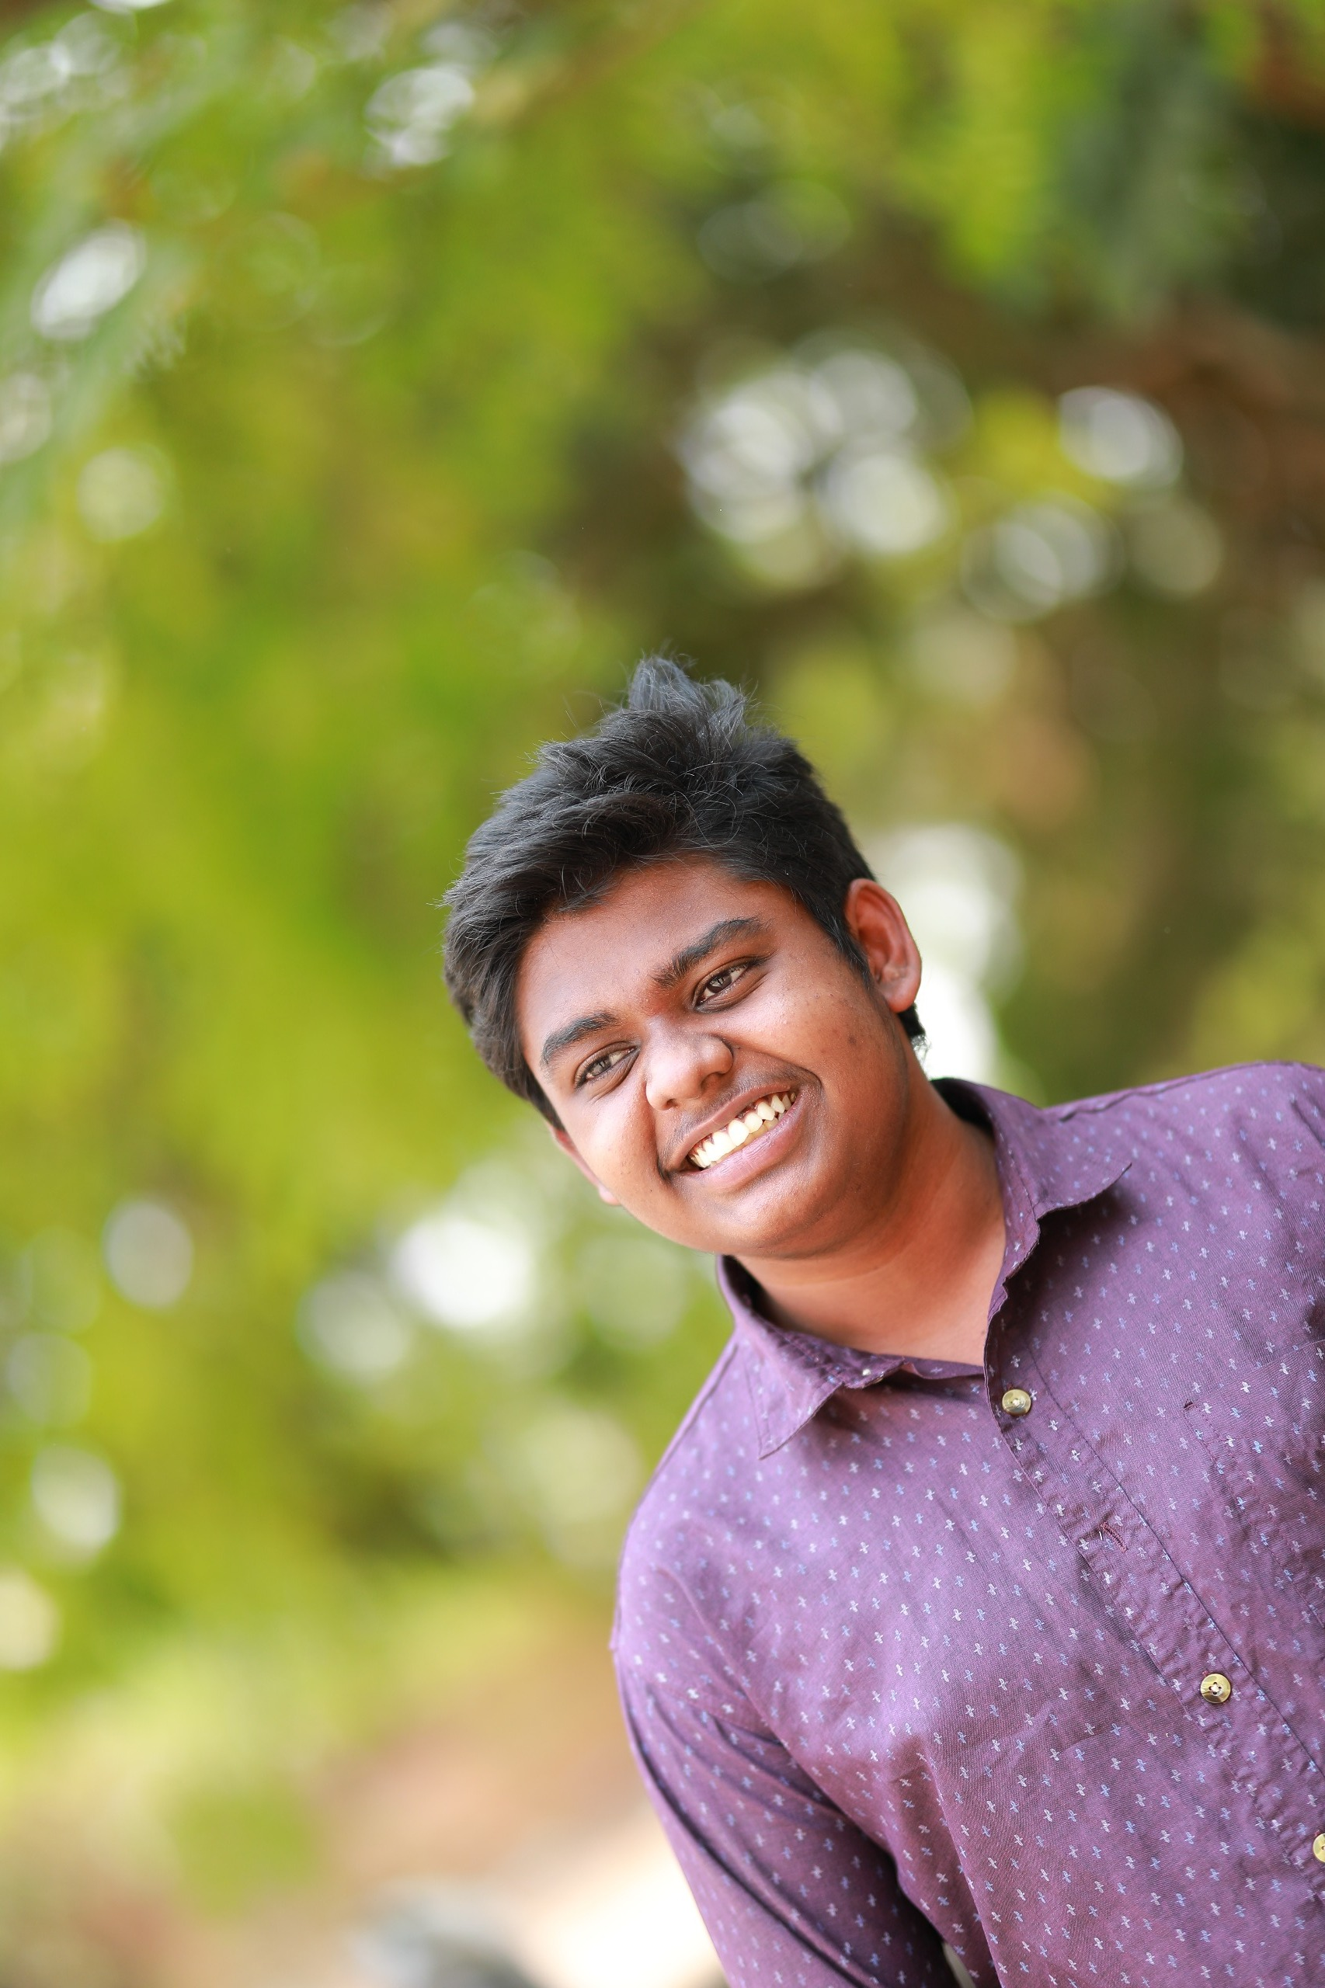
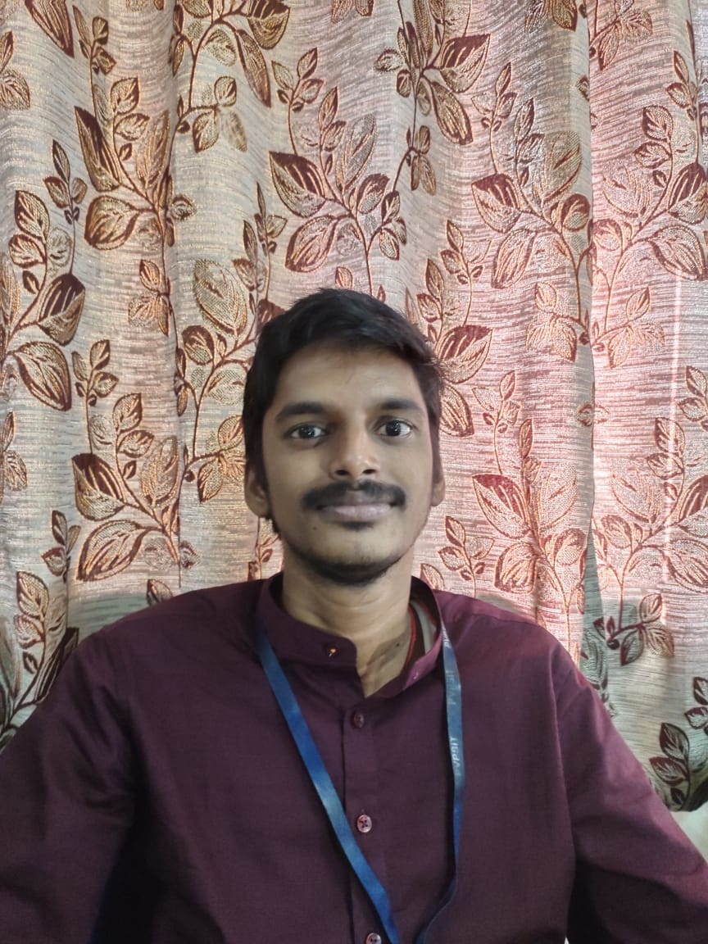
Hack the Future: A Gen AI Sprint Powered by Data
Data and AI Week
Team details
TEAM NAME: Smart Square
J Madhavan
P Revanth Kumar
Photo

Slide 5
Entry Submission Summary
Idea Title (Provide a concise and impactful title for your idea.) | CareLink AI: Dual-Agent System for Medical Documentation and Elderly Well-being
Team Name | Smart Square
Problem Statement | Empowering Elderly Care with multi agent AI system
Proposed Solution | AI-Powered Transcription: Converts spoken medical conversations into accurate text. Clinical NLP Processing: Extracts critical medical information from text The Solution Offered : A Generative AI-enabled NLP tool that automatically transcribes and formats medical documentation from surgical talks during operations and surgeries. It saves doctor’s significant time and efforts , avoid errors, and facilitates research and training and made the task simple for the doctors, surgeons and even the medical explorers

Slide 6
Problem Statement
Challenge Overview:
As the global population ages, ensuring the well-being of elderly individuals living independently presents a major challenge.
The goal of this hackathon is to develop a multi-agentic AI system that assists elderly individuals by providing real-time monitoring, reminders, and safety alerts, while promoting health management and social engagement. The agents will work together to create a collaborative support system, involving caregivers, healthcare providers, and family members to ensure optimal care and peace of mind.
The system should monitor health, detect unusual behavior, and provide alerts in case of emergencies. It should also provide reminders to manage daily routines, such as medication schedules, appointments, and daily activities.
Current Process:
Healthcare Provider: Monitors health data (e.g., heart rate, blood pressure, glucose levels) through wearable devices and gets alerted if abnormal values are detected.
Safety Monitoring System: Uses sensors or wearables to track movement, activity, and falls. If an elderly person falls or exhibits unusual behavior (e.g., remaining stationary for too long), the system triggers an alert.
Daily activity Reminder System: Sends reminders in form of voice notes to the elderly individual for medication intake, scheduled appointments or daily activities.
Expected Technical Output: Multiagent framework

Slide 7
Proposed Solution: Concept, Approach, and Prototype
AI-Powered Transcription: Converts spoken medical conversations into accurate text.
Clinical NLP Processing: Extracts critical medical information from text
The Solution Offered : A Generative AI-enabled NLP tool that automatically transcribes and formats medical documentation from surgical talks during operations and surgeries. It saves doctor’s significant time and efforts , avoid errors, and facilitates research and training and made the task simple for the doctors, surgeons and even the medical explorers

Slide 8
Technologies Used
Speech Recognition: Whisper API, Google Speech-to-Text
Natural Language Processing: OpenAI GPT models, BERT, SpaCy.
Data Processing: Python, Pandas, NumPy
Frameworks & Tools: Flask/Django for backend, React for frontend
Database: MYSQL/MongoDB for storing structured data

Slide 9
Conclusion
Our solution, CareLink AI, effectively combines Generative AI and a multi-agentic framework to solve two critical healthcare challenges. It automates real-time surgical documentation with high accuracy, reducing medical errors and saving doctors valuable time. Simultaneously, it provides a proactive support system for elderly individuals through health monitoring, voice-based reminders, and safety alerts.
By leveraging technologies like Whisper, BERT, and spaCy, and integrating with systems like EHR and wearable devices, our dual-module solution ensures better patient outcomes, reduced administrative load, and enhanced elderly care. This project not only meets the hackathon objectives but also shows high scalability, social impact, and real-world applicability.

Slide 10
References/Other details
Research Papers & Articles:
Automatic Speech Recognition (ASR) in Healthcare – IEEE Xplore
https://ieeexplore.ieee.org
Reference Tools & APIs:
Google Speech-to-Text API (Medical model)
https://cloud.google.com/speech-to-text
OpenAI Whisper: Automatic Speech Recognition (ASR) Model
https://github.com/openai/whisper
ClinicalBERT: Pretrained NLP Model for Medical Text
https://arxiv.org/abs/1904.05342

Slide 11
Thank You

